Slide 1
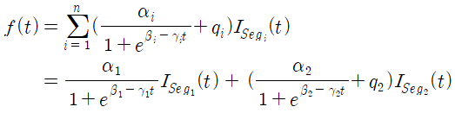
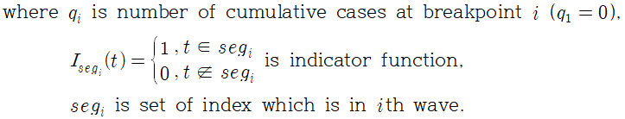
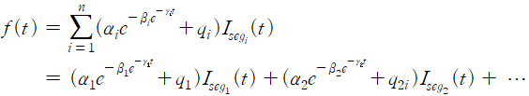
2. Paired Permutation Test
Result Analysis
Logistic, Gompertz 모델에 대해 segment 별로 Paired Permutation t-test 시행
- Logistic :
- Gompertz :

Slide 2
2-1. Logistic Coefficient “a”
Result Analysis
- Logistic Model의 a coefficient (empirical p-value : 0.601 )

Slide 3
2-1. Logistic Coefficient “b”
Result Analysis
- Logistic Model의 b coefficient (empirical p-value : 0 )

Slide 4
2-1. Logistic Coefficient “c”
Result Analysis
- Logistic Model의 c coefficient (empirical p-value : 0 .392 )

Slide 5
2-2. Gompertz Coefficient “a”
Result Analysis
- Gompertz Model의 a coefficient (empirical p-value : 0 .06 )

Slide 6
2-2. Gompertz Coefficient “b”
Result Analysis
- Gompertz Model의 b coefficient (empirical p-value : 0 )

Slide 7
2-2. Gompertz Coefficient “c”
Result Analysis
- Gompertz Model의 c coefficient (empirical p-value : 0 .017)

